Slide 1
CASSINI A SDN BASED NETWORK AUOTOMATION TOOL
Aashi Gupta, Manish Singh Kushwaha , Pamunugundla Vamshi Sai
Turbo Summer Interns

Slide 2
AGENDA-:
1
A MOVE FROM TRADITIONAL NETWORKS TO SOFTWARE DEFINED NETWORKS(SDN)
2
ADVANTAGES OF SDN
3
SDN CONTRIVANCE: EXPLAINATION OF CASSINI

Slide 3
A MOVE FROM TRADITIONAL NETWORKS TO SOFTWARE DEFINED NETWORKS

Slide 4
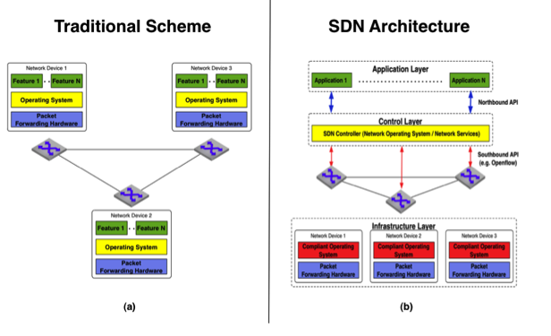
TRADITIONAL NETWORK VS SDN

Slide 5
PARAMETER | TRADITIONAL NETWORKS | SOFTWARE-DEFINED NETWORKS
CONTROL PLANE | They have distributed control plane. | They have logically centralized control plane.
HARDWARE | They are Hardware appliances with inbuilt intelligence. | They are configured using open software.
FLEXIBILITY | Inflexible to topology changes and new advanced protocols. | Flexible and Virtualized Networks.
REPROGRAMMABILITY | Nodes are programmed to use protocols which are singular to one kind of node.eg:Switches,Routers | Nodes here can be reprogrammed to possess any feature.

Slide 6
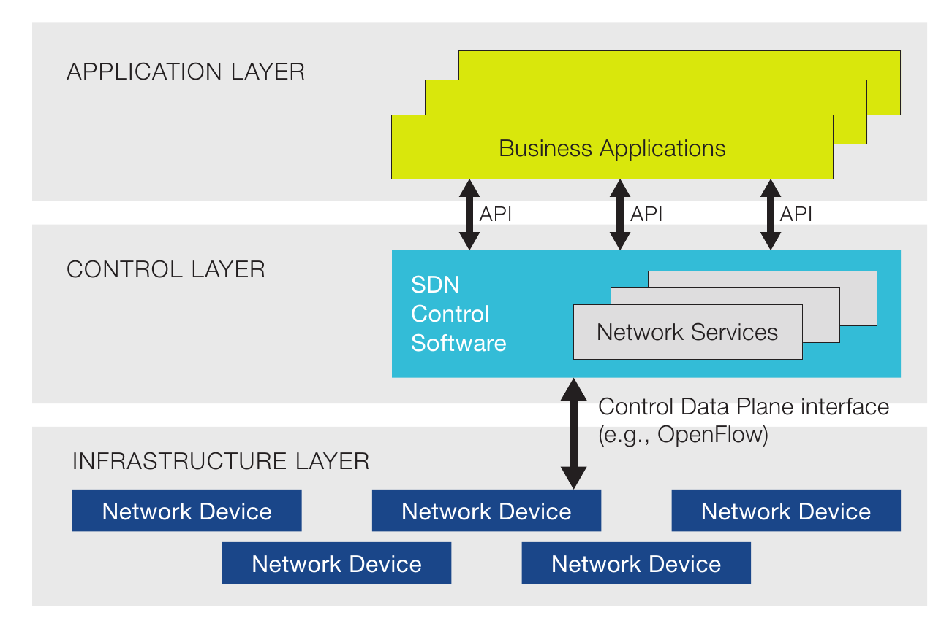
SDN ARCHITECTURE
Software-defined networking (SDN) is an approach to computer networking that allows network administrators to programmatically initialize, control, change, and manage network behavior dynamically via open interfaces.​

Slide 7
ADVANTAGES OF SDN

Slide 8
PROBLEM OF VENDOR LOCKING
Vendors deliver packages of proprietary hardware, operating systems and applications bundled together. Unlike the PC industry of today, you cannot choose to buy network hardware from one vendor, an operating system from another vendor and applications from a third vendor.
Vendor lock-in is a major barrier to the adoption of cloud computing, due to the lack of standardization.
The idea of SDN is to create open interfaces between these layers so the networking market resembles the PC market with competition at each layer of the stack.
Openflow is the open interface between hardware and the network operating system - perhaps roughly analogous to x86.OpenFlow is a communications protocol that gives access to the forwarding plane of a network switch or router over the network.

Slide 9
ADVANTAGES OF SDN:
Centralised network Provisioning
Holistic Enterprise Management
More Granular Security
Hardware Savings and reduced Capital Expenditures
Lower Operating Costs
Network abstraction for clouds
Guaranteed Content Delivery

Slide 10
NETWORK FUNCTION VIRTUALIZATION
Together, SDN and NFV represent a path toward more generic network hardware and more open software, where the centralized control and management decreed in SDN can in part be realized through the virtualized functions and capabilities that come from NVF.
Network function virtualization (NFV) is a network architecture concept that uses the technologies of IT virtualization to virtualize entire classes of network node functions into building blocks that may connect, or chain together, to create communication services
SDN is Separation of control and data, centralization of control and programmability of network whereas NFV is Relocation of network functions from dedicated appliances to generic servers
OpenvSwitch is open source implementation of a distributed virtual multilayer switch. The main purpose of Open vSwitch is to provide a switching stack for hardware virtualization environments, while supporting multiple protocols and standards used in
OVS is critical to many SDN deployments in data centers because it ties together all the virtual machines (VMs) within a hypervisor instance on a server.

Slide 11
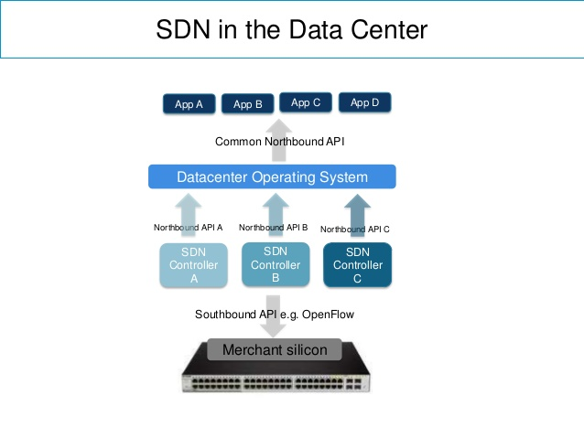
SDN BASED DATA CENTER
A data center is a facility used to house computer system with components,suchas telecommunications and storage systems. It generally includes redundant or backup power supplies, redundant connections, environmental controls (e.g., air conditioning, fire suppression) and various security devices
Data Center Optimization is the ability to use SDN and NFV, optimizing networks to improve application performance by detecting and taking into account affinities, orchestrating workloads with networking configuration
In data centers east-west traffic is very high and the reliability of each virtual machine is small so reliability is very important. East-west traffic in the data center and software-defined networking (SDN) are related in that many SDN solutions look to solve the challenges presented by this dynamic flavor of traffic

Slide 12
SDN CONTRIVANCE:- EXPLAINATION OF CASSINI

Slide 13
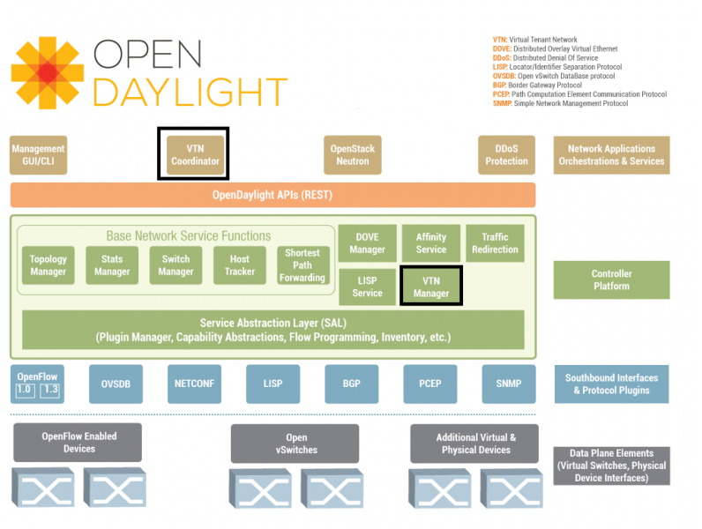
OPENDAYLIGHT
ODL Components
Service Abstraction Layer
Data Packet Service
Switch Manager
GUI

Slide 14
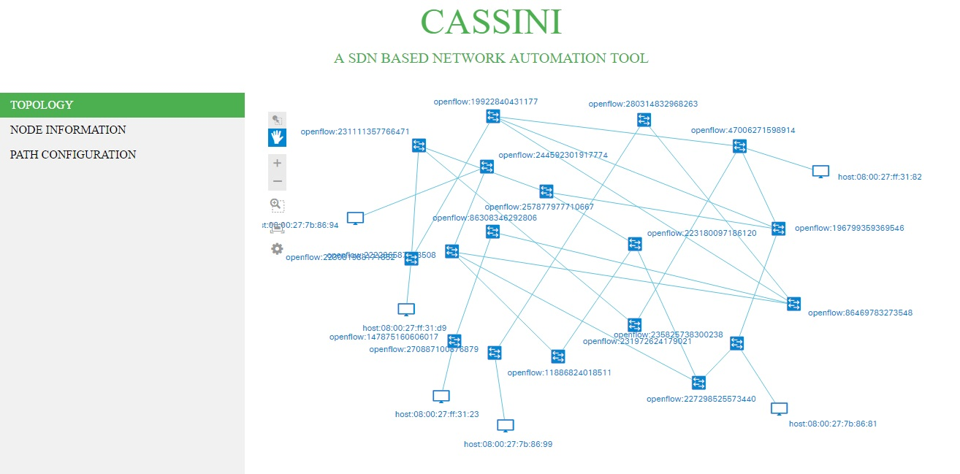
PROBLEM STATEMENT:
WE ARE PROVIDED WITH A NETWORK AND OUR TASK IS TO AUTOMATIZE THAT NETWORK USING SDN IN TERMS OF-:
CONNECTIVITY
RE-ROUTING
QUALITY OF EXPERIENCE(QoE)

Slide 15
Access provisioning tool(NA)
FRONT-END
MONGO-
CLIENT
MONGO-DB
PHP
FUNCTION CALLS
JAVASCRIPT
AJAX
TCP
SOCKET
CONNECTING
THE
DOTS
BACK-END(JAVA)
MONGOCLIENT
REST API
ODL
REST LIBRARY
OPENFLOW
NETWORK

Slide 16
PHYSICAL SETUP:
CASSINI
172.16.52.74
OPENDAYLIGHT CONTROLLER
172.16.52.9
TEST ENVIRONMENT
172.16.52.140
172
NETWORK
DATABASE
172.16.52.73

Slide 17
COMPUTATIONS AND WORKING:
The Application will retrieve the topology information from SDN Controller and the topology based on this data will be displayed in the web page along with the information regarding hosts and nodes.
The application detects hosts whenever they connect to or disconnect from the agglomeration of nodes.
The network access application can ask Cassini to configure a path between a host and a server. The application will configure the path that is the shortest by default.
The shortest path between edge nodes in the network will be calculated and stored in the database for path configuration.
If a node is added or deleted from the network, all the paths will be reconfigured accordingly and stored in database. The topology is checked every 30 seconds for any changes.
If a host moves in a network from one position to other, we remove the old path and ask the access provisioning application for a path configuring trigger.

Slide 18
Contd.:
If an intermediary switch in the path fails, reconfiguration is done for all the hosts’ path going through that switch. This reconfiguration is done within the interval of 30 seconds.
The application also assigns weight to each link between nodes. And based on the traffic between the nodes the weight of the link is modified to reflect the bandwidth consumed.
These weights which will be used for the best path calculation.
We have a predefined threshold for making a decision to switch the user to a best path from the shortest path.
This comparison between sum of the weight along the path to the threshold is done every 30 sec. .
If there is an increase in traffic then the user is shifted from the shortest path to the immediate best path available. If the traffic increases on selected best path too, then we move to the second best path available. This path analysis is made every 2 minutes by the application.

Slide 19
Contd-:
Cassini is performing a trend analysis on the traffic data to make the decision to shift to a best path.
T denotes a sample space of 5 path sums where each sample is collected every 30 seconds.
T is categorized in to the following,
Increasing Trend Ex: T = (35, 40, 45, 50, 60)
Decreasing Trend Ex: T = (65, 60, 55, 45, 40)
Normal Trend Ex: T = (60, 57, 55, 58, 55)
Sudden Decrease Ex: T = (60, 55, 30, 25,10)
Sudden Increase Ex: T = (30, 50, 55, 60,85)
If sum of the differences of the samples is greater than 50 we make a decision to change the path.
With Cassini we can also retrieve statistics related to ports, nodes and flows.

Slide 20
TECHNOLOGY HOARD:
1
MONGO DB
Mongo DB is a NoSQL , document database with Scalability and Flexibility .It stores data in flexible , JSON like documents and is container of collections . Document is set of key value pairs .Fields can be varied from document to document and data structure be changed over time
2
NETBEANS IDE 8.0.2
A software development platform written in java . But it also supports other languages like C++. It provides integrated support for scripting languages like PHP and Javascript.It has Extensible Platform
3
LUBUNTU 17.04
Lubuntu is fast and lightweight operating system. The core of the system is based on linux. It has low hardware (RAM) requirements
4
OPENDAYLIGHT
The Open Daylight Controller is a pure software and as a JVM it can be run on any OS and Metal as long as it supports Java
5
MOBAXTERM
It provides important remote network tools and unix commands to windows desktop in single exe file.It supports multi tab environment and multi execution mode we can create and manage sessions
6
APACHE HTTP SERVER
Web server with good reliability and performance.

Slide 21
FRONT-END:

Slide 22
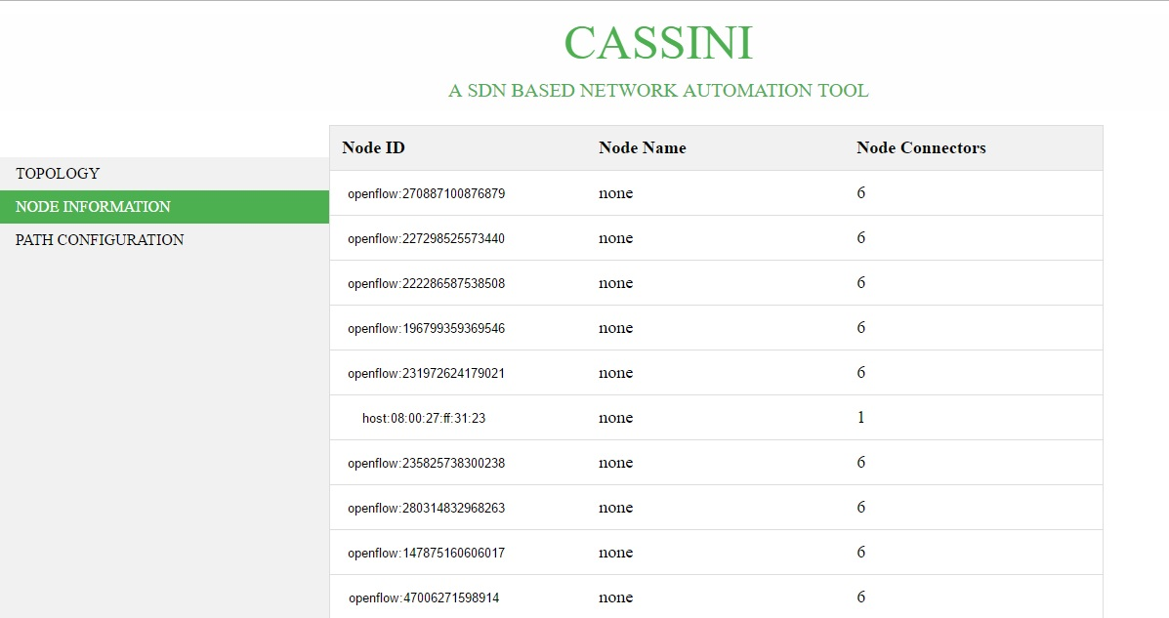
Contd.:

Slide 23
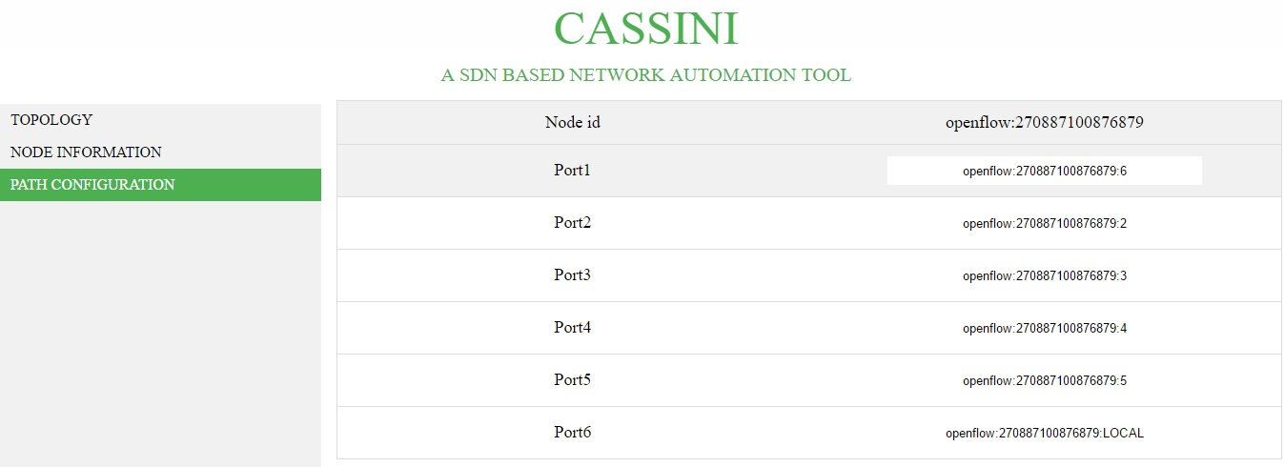
Contd.:

Slide 24
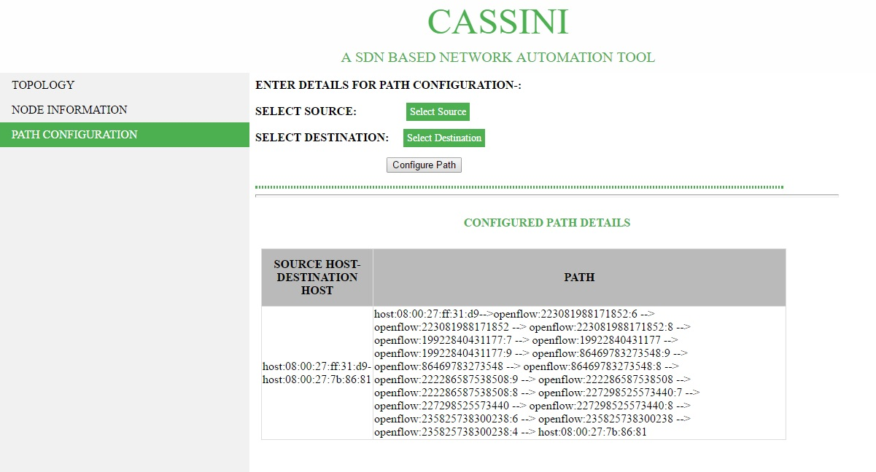
Contd.:

Slide 25
Thank you
Team MAV
Turbo Summer Interns

